Slide 1
REDISCOVERING
THE MARRIAGE
GENESIS 2:21-25

Slide 2
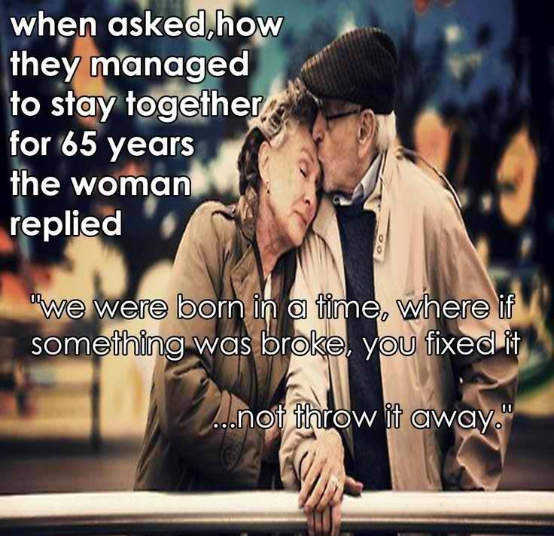
THE ART OF MARRIAGE

Slide 3
REDEFINING LOVE & MARRIAGE IN 21ST CENTURY
#1. SEXUAL INFEDILITY should be a part of majority marriages
#2. Chris Messina (Hashtags to Twitter) monogamous but open sexual relationship with anyone to spark his marriage.
#3. Who needs husband? Women are freezing their eggs and active choice motherhood.
#4. Beta Marriages – A short-term marriage with cohabiting couples in sexual interactions.

Slide 4
Paradoxy of Marriage
1. The most Beautiful & Danger in human life
2. The greatest Joy & Sorrow in human heart
3. The greatest Attraction & Distraction in human mind
4. The precious Dream & Nightmares in human reality
5. the greatest source of Hope & Fear in human history

Slide 5
The Divine Option
1. Marriage was created by God
2. Marriage is a divine product
3. Marriage is a divine option
4. Marriage is not necessary to fulfill God’s purpose for your life
5. Marriage is a choice and not mandatory

Slide 6
A Divine Idea
Marriage is such a beautiful idea only God could have thought of it

Slide 7
PRINCIPLES OF MARRIAGE
A SUCCESSFUL MARRIAGE HAS LITTLE TO DO WITH LOVE
LOVE DOES NOT GUARANTEE SUCCESS IN MARRIAGE
LOVE BRINGS HAPPINESS BUT IT DOES NOT MAKE MARRIAGE WORK
THE ONLY THING THAT MAKES ANYTHING WORK IS KNOWLEDGE
LOVE DEPENDS ON WHAT WE FEEL NOT WE KNOW.

Slide 8
ADAM GAVE NAME TO HIS WOMAN
“WOMAN” Genesis 2:23
#
# # # # # # # # differentiates by NAME
#
“EVE” Genesis 4:1

Slide 9
Cleave (Dabaq) = Chase
Genesis 2:24 ~ “Therefore a man shall leave his father and mother and BE JOINED (NIV) CLEAVE (KJV) = Dabaq (to pursue closely, to chase)
MEN: that means AFTER MARRIED (not only before it) you must still chase her – your wife.
WOMEN: that means AFTER MARRIED – you should prepared yourself CHASIBLE (in better degree)

Slide 10
“NAKED” = not ashamed
‘IF’ two of you were naked and felt guilty; it means YOU are with A WRONG PERSON! You are afraid to be discovered!
Check your level of guilty – IT MEASURES THE SANCTITY OF YOUR RELATIONSHIP.
You shouldn’t INTIMATE until you are married.
Marriage (GK. Gameo – root of GEM) where we got Diamonds, Sapphires, Emeralds, Rubies. They are products of HEAT, PRESSURES, TIME & FUSION
Marriage is the fusion of TWO distinct human elements into ONE.

